Slide 1
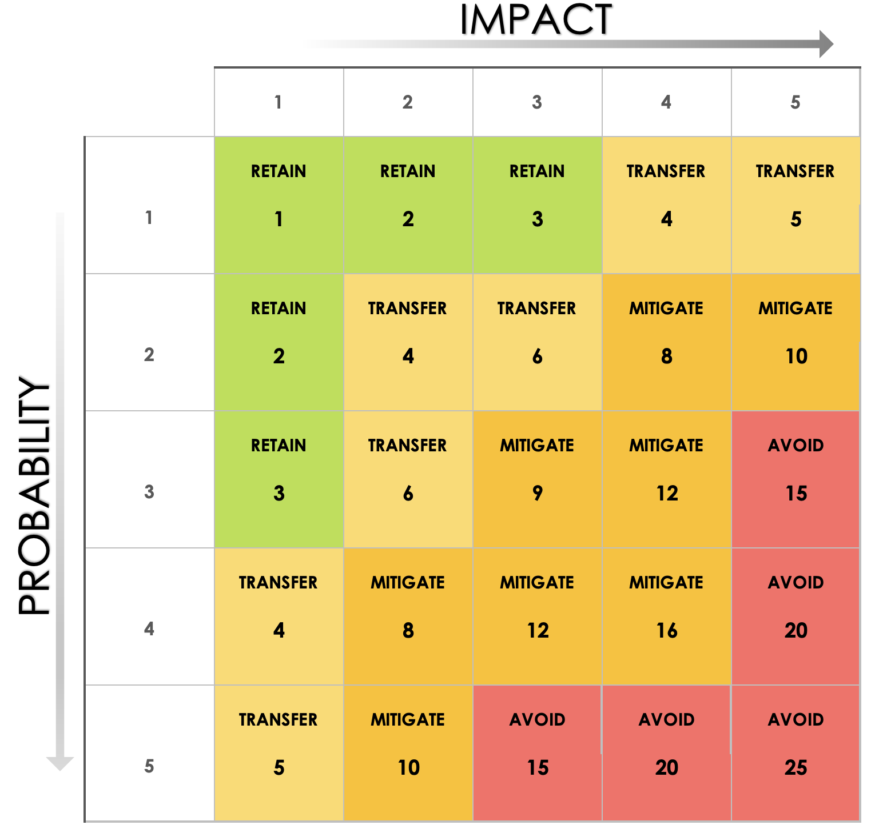
Risk Response Matrix Template

Slide 2
Risk Rating Matrix
How to Use This Matrix
Identify the risk, clearly describe it, and assign it an ID.
Rate how likely the risk is to occur. 1 - 2 = Unlikely 3 - 4 = Possible 5 = Almost Certain
Score the Impact. 1 - 2 = Minimal Impact 3 - 4 = Moderate Impact 5 = Critical Impact
Calculate the risk score. Multiply probability by impact to determine overall risk severity.
Determine the response strategy. Avoid: Eliminate the risk. Transfer: Shift the risk to a third party. Mitigate: Reduce the likelihood or impact. Retain: Accept and monitor the risk.
Plan and assign actions
Monitor and review

Slide 3
Risk Register
Risk ID | Title | Risk Description | Category | Probability | Impact | Risk Score | Response Type | Owner | Planned Response | Status | Target Date
Provided by Smartsheet, Inc.

Slide 4
DISCLAIMER Any articles, templates, or information provided by Smartsheet on the website are for reference only. While we strive to keep the information up to date and correct, we make no representations or warranties of any kind, express or implied, about the completeness, accuracy, reliability, suitability, or availability with respect to the website or the information, articles, templates, or related graphics contained on the website. Any reliance you place on such information is therefore strictly at your own risk.

